Slide 1
Quantifying vegetation distribution and structure using high resolution drone-based structure-from-motion photogrammetry
Junzhe Zhang
Department of Geography, UCLA
Advisor: Prof. Okin
2017/7/11

Slide 2
Outline
Purpose
Study sites
Methods
Results
Discussion
Summary

Slide 3
Purpose
Land management agencies need vegetation structure to monitor the condition of rangelands.
Multispectral remote sensing has been widely used to monitor vegetation coverage and its change; however, the vertical structure of vegetation is restricted to the 2D images.
Field observation uses the different methods to measure the structure of vegetation; however, these methods are laborious, time-consuming, and susceptible to undersampling in spatial heterogeneity.
Light detection and ranging (LiDAR) is a commonly used technique to measure the spatial pattern of vegetation; however, it is very expensive.
A structure-from-motion (SfM) photogrammetry produced by drone-based remote sensing can provide three advantages: 1. 3D model, 2. High spatial resolution, 3. Cheap and fast.

Slide 4
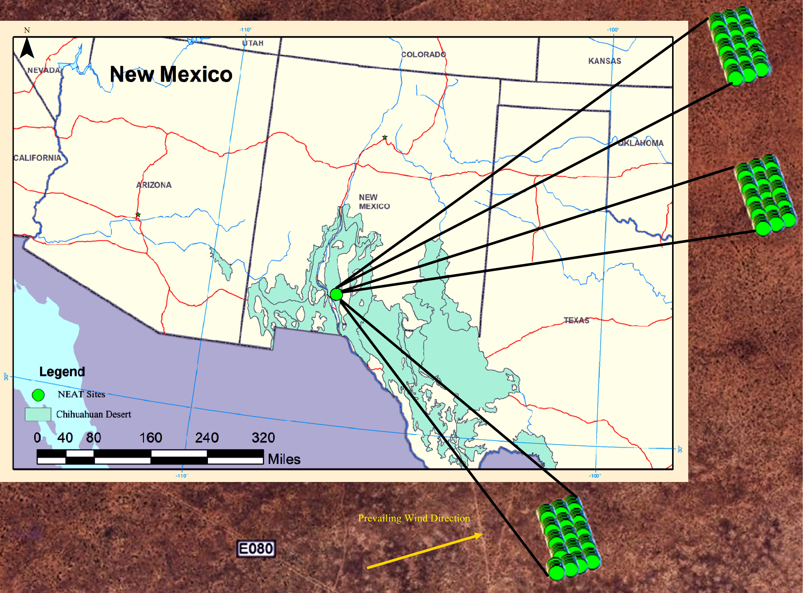
Study sites
Notes:
The study site is on the Nutrient Effects of Aeolian Transport (NEAT) sites initiated in 2004 at the Jornada Experimental Range (JER) in New Mexico.
The mean direction of the wind is southwest and wind erosion events mainly happen in spring. The dominant shrub is honey mesquite, and the dominant grass are grama grass and dropseed grass.

Slide 5
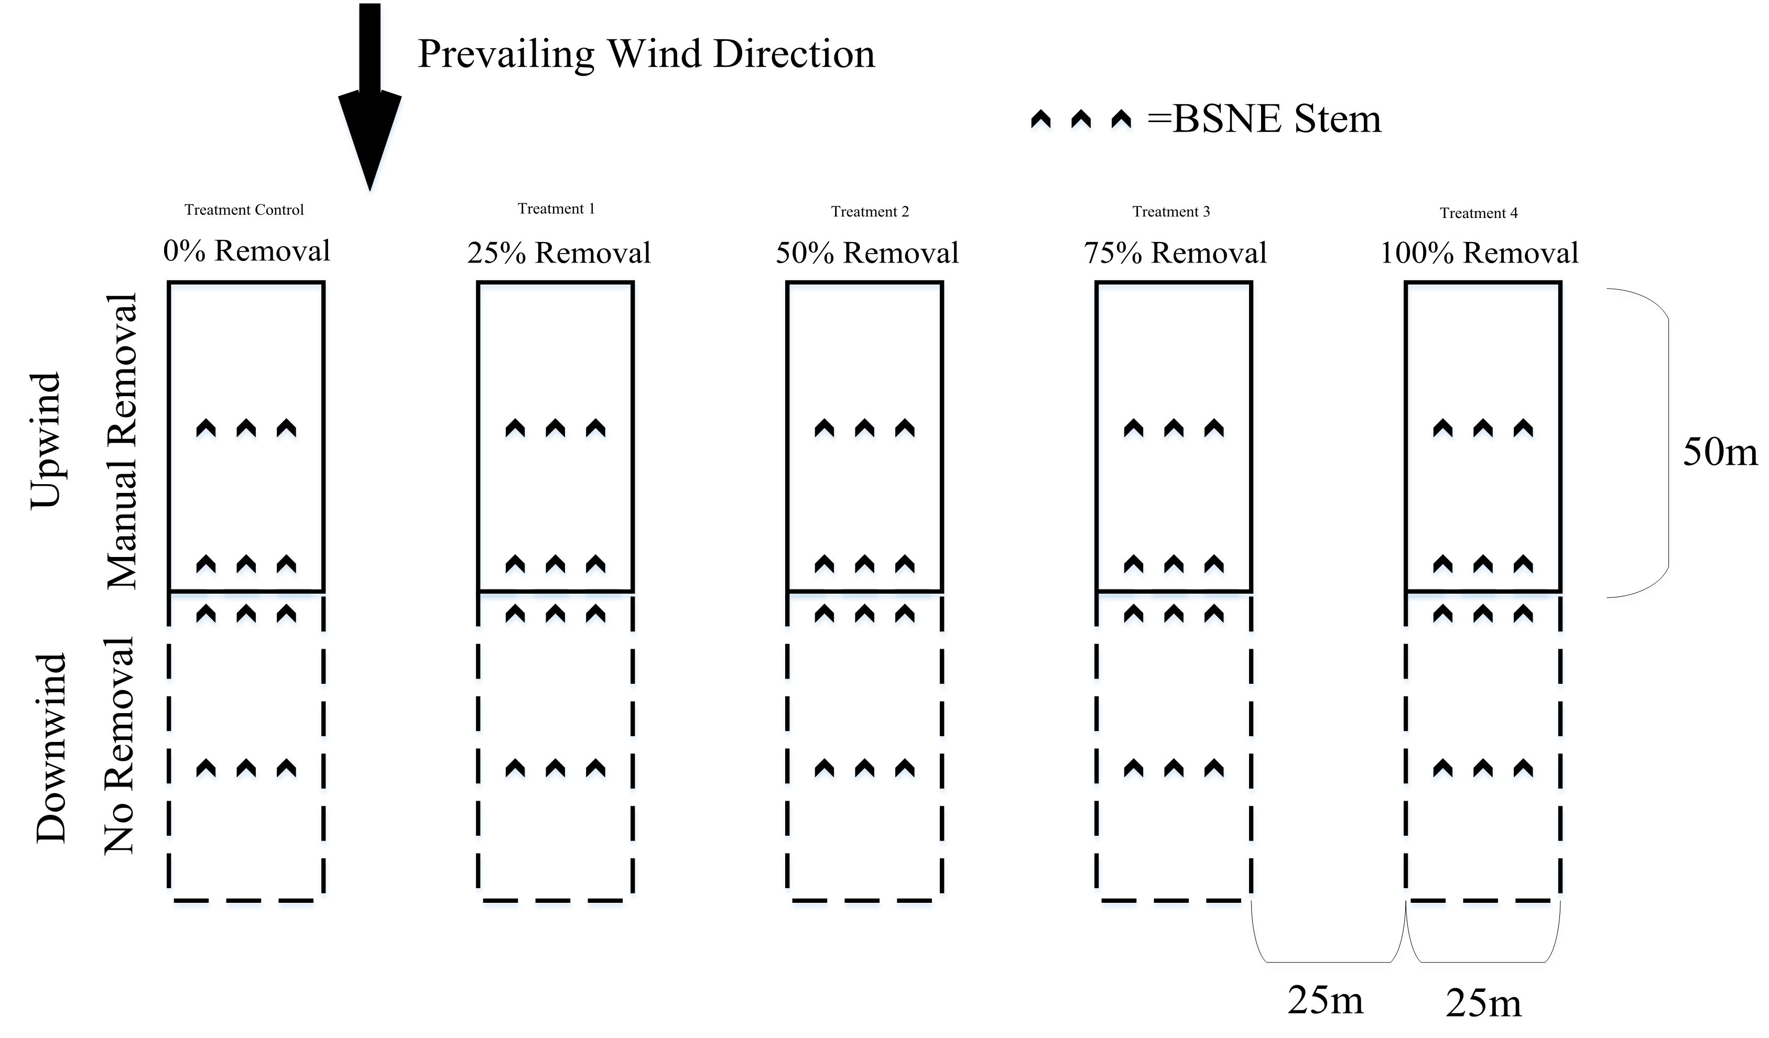
Study sites
Notes:
There are 5 treatments in each block. The grass cover reduction is from 0% to 100% in the upwind areas. The buffer of inter-treatment is 25 m in order to reduce the interference between treatments.
The length of each treatment is 100 m and the width is 25 m.

Slide 6
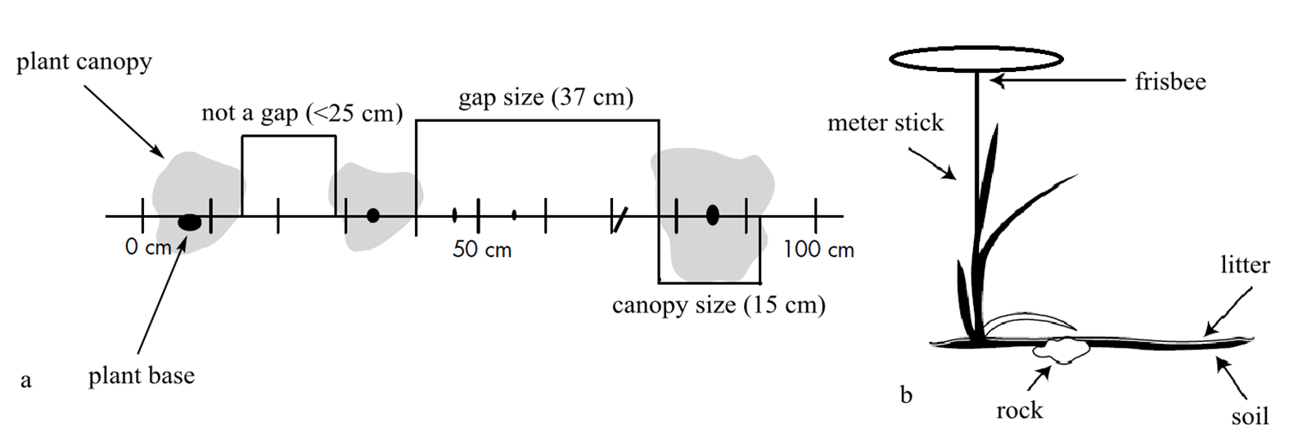
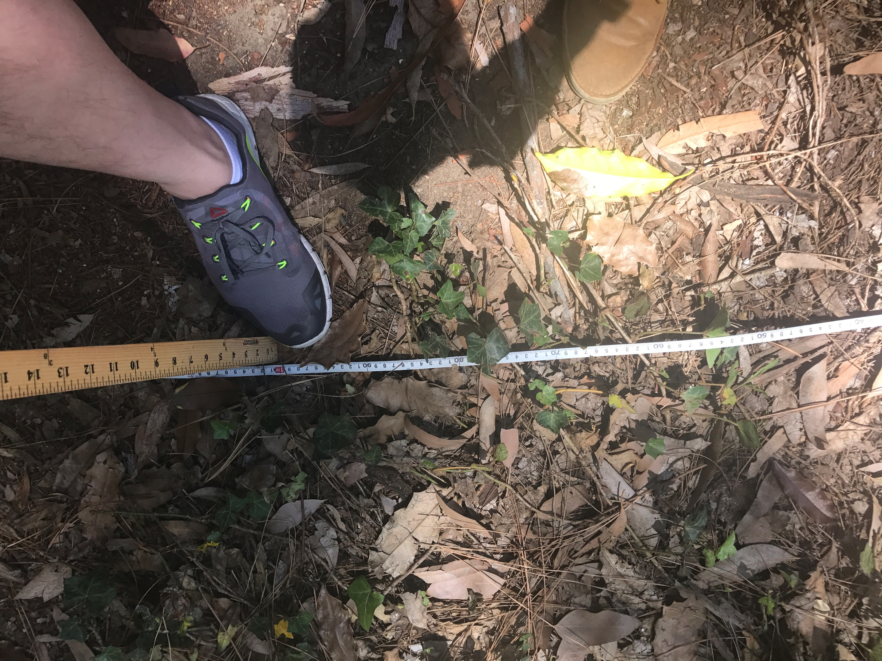
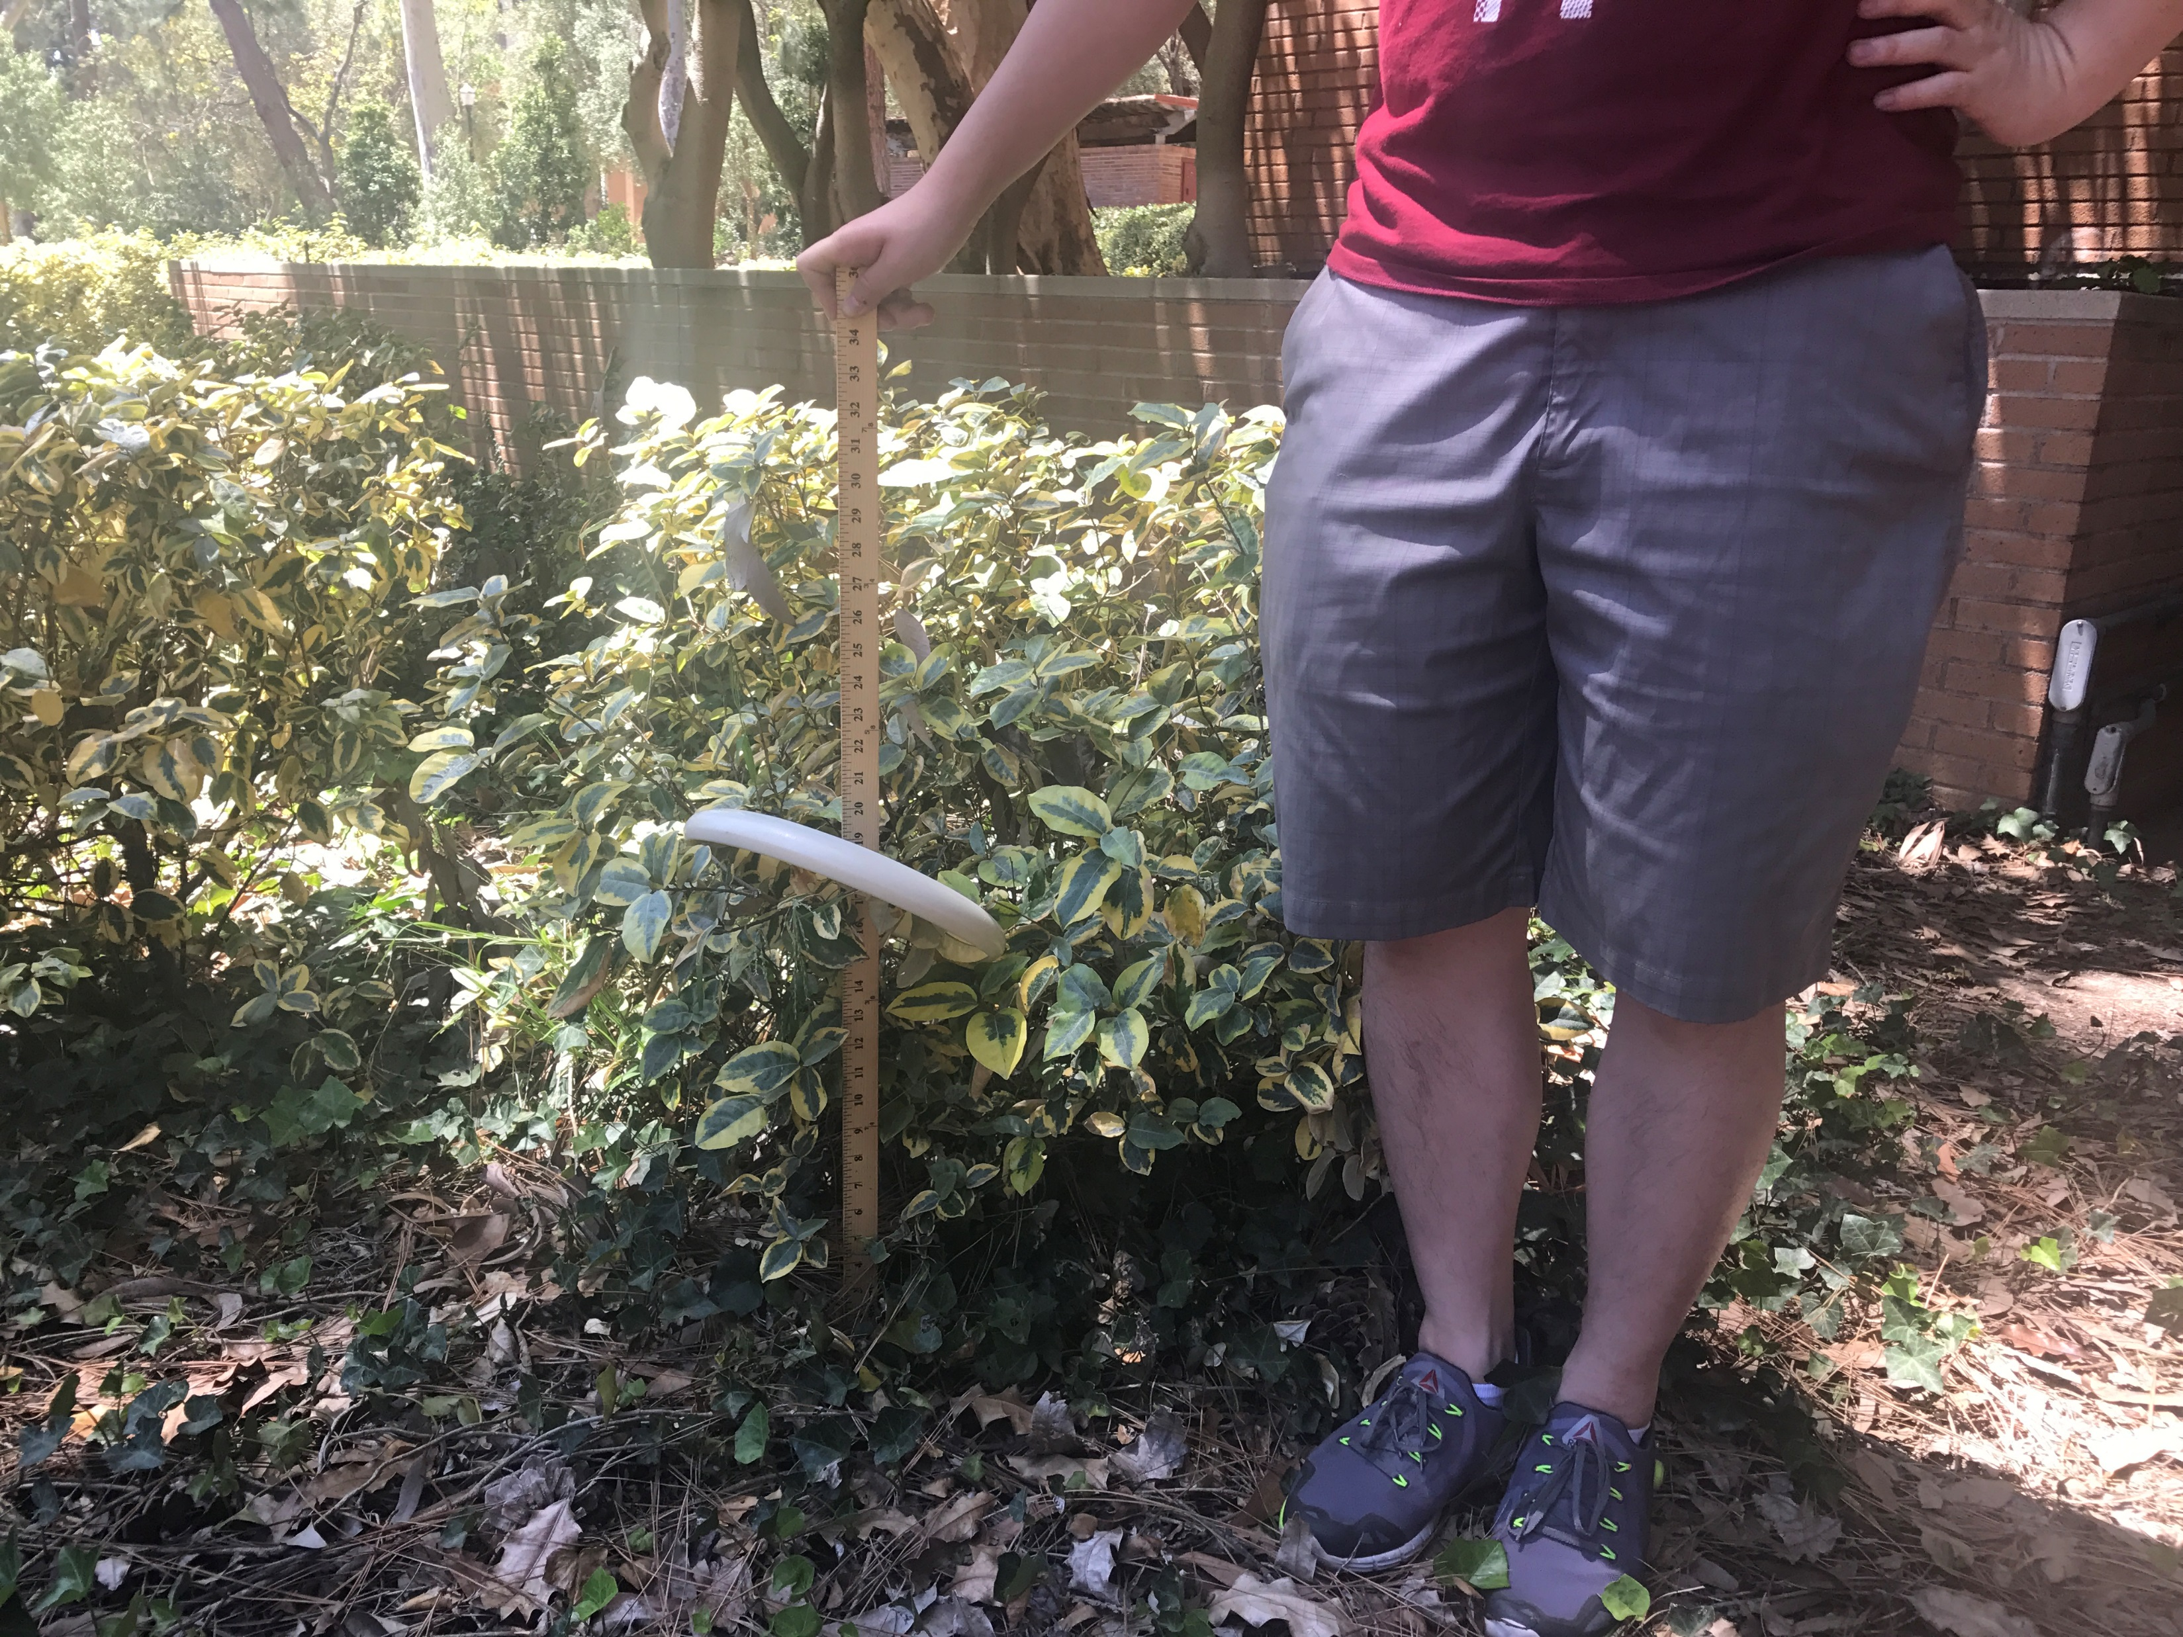
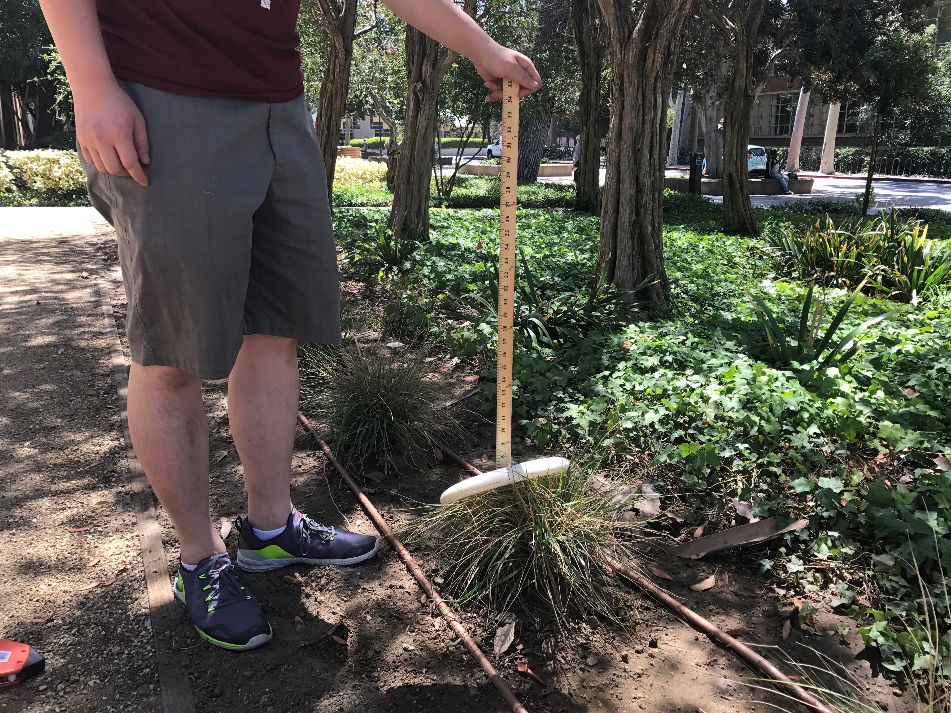
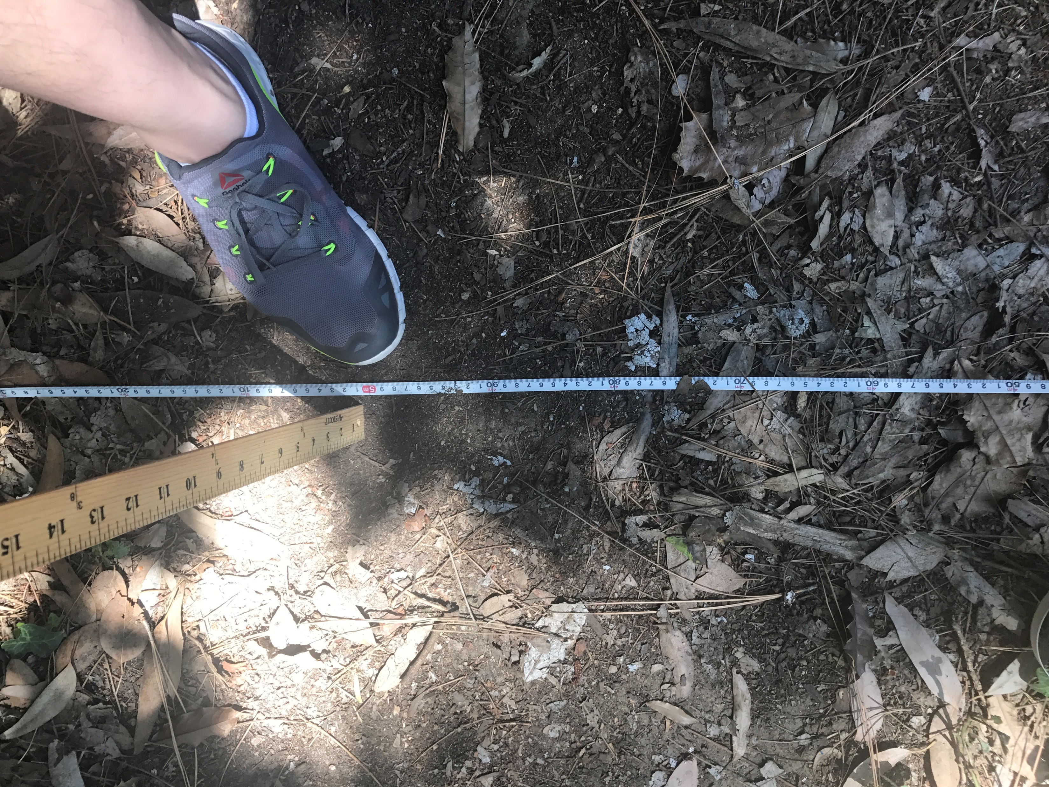
Method: field data acquisition
LPI (line-point intercept)
Canopy size, bare soil gap size
Plant height
Notes:
1. Place a 100-m tape (transect line) from the beginning of the upwind area to the end of the downwind area.
2. Walk along the tape and check the scale of tape on the same side with you.
3. Record bare soil gap size greater than 25 cm as well as the projected length of plant canopy in the transect line.
1. Put a meter stick on the transect line and make it perpendicular to the surface.
2. Place an Ultimate frisbee disc with a hole in the center on the meter stick, and drop it until it rests on the plant or the surface.
3. Record the height of the frisbee.
1. Place a steel pole on the ground along the transect line, and record the type of surface material (Shrub, Grass, Litter, and Soil).
2. Observations were made at 1 m intervals along the transect line.

Slide 7
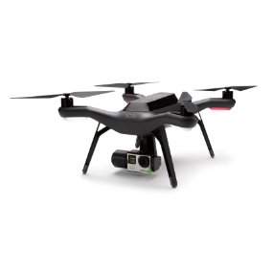
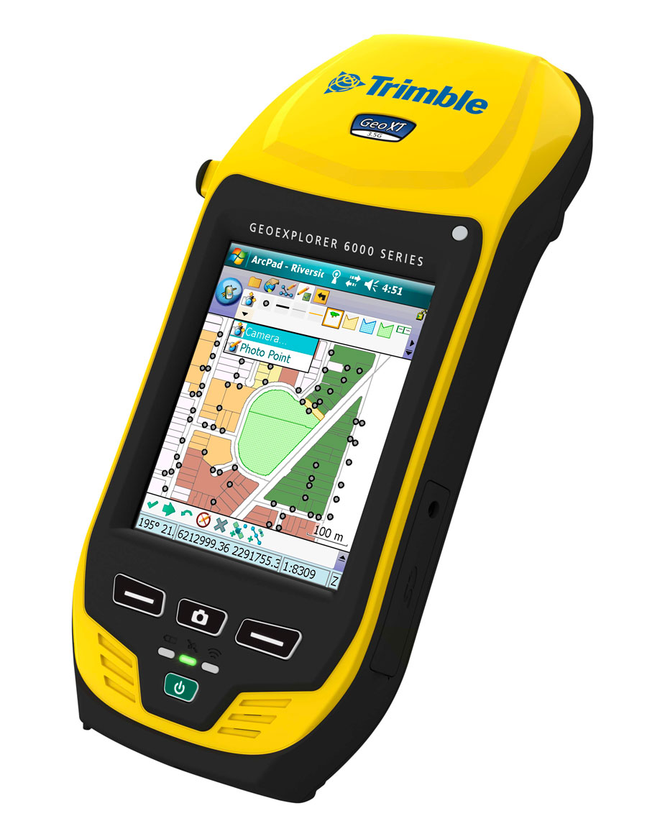


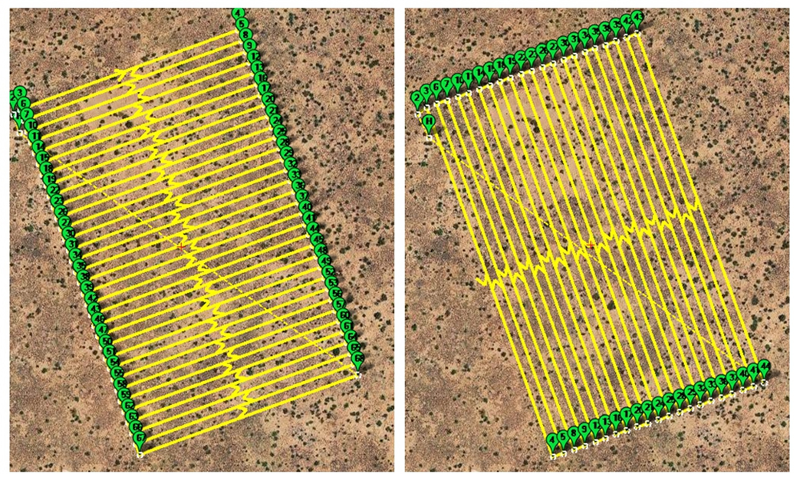
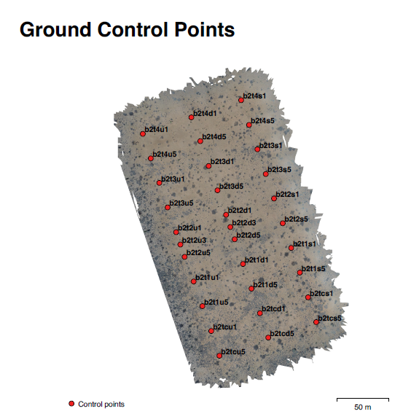
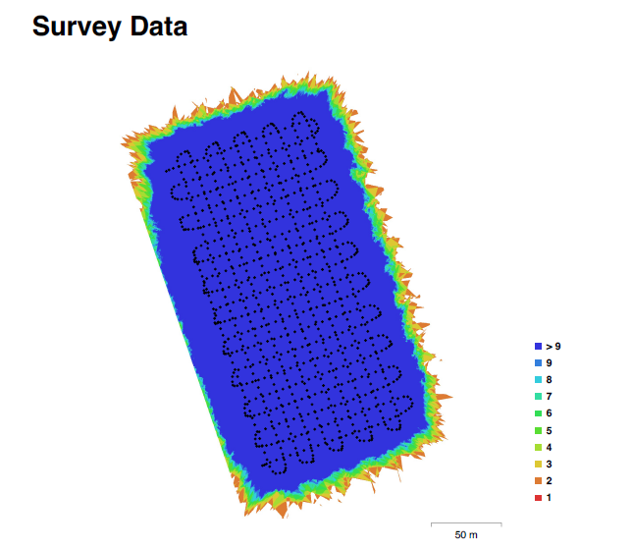
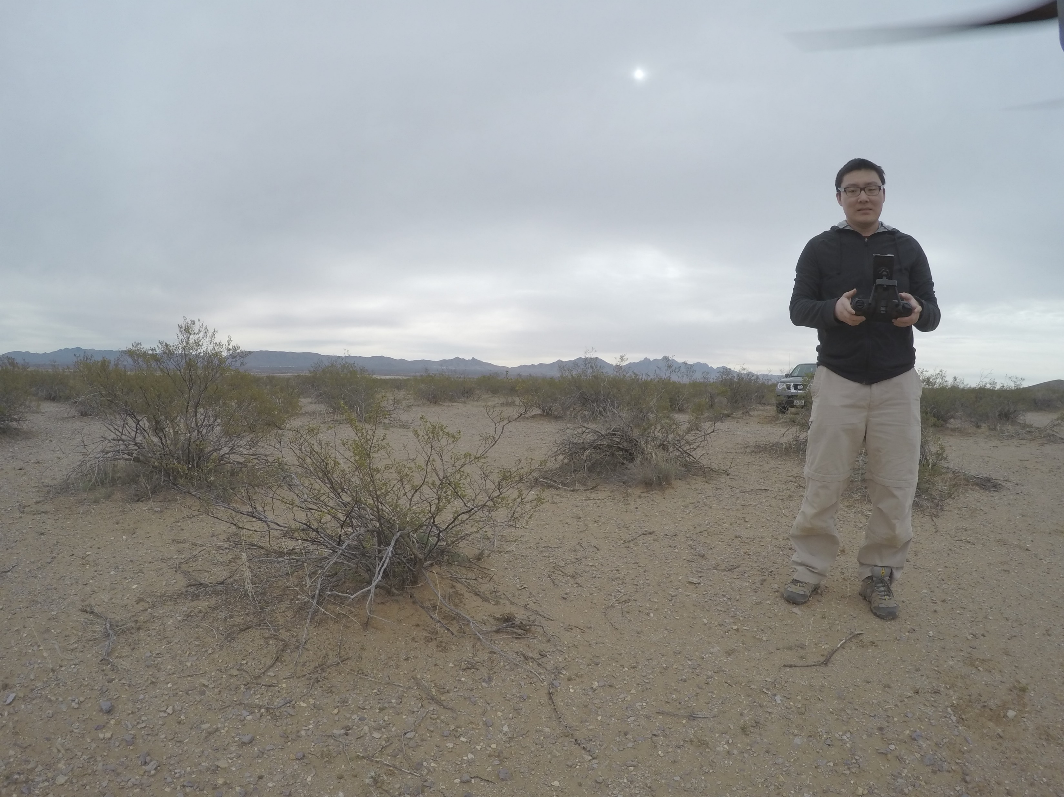

Method: image data acquisition and processing
Notes:
The image was obtained by a 3D Robotics SOLO drone equipped with a GoPro Hero4 camera. Trimble GPS was used to take the location of GCPs (ground control points) of all three blocks. Mission Planner was used to draw the waypoints for the flights. The drone was flown in north-south and east-west directions at 12 m altitude. After all these things, I was free to fly the drone. The SfM model was built by PhotoScan.

Slide 8
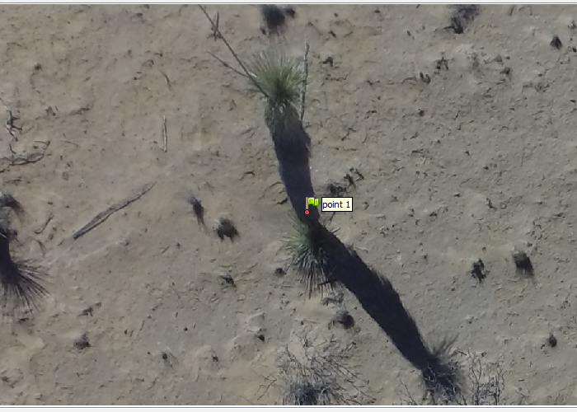
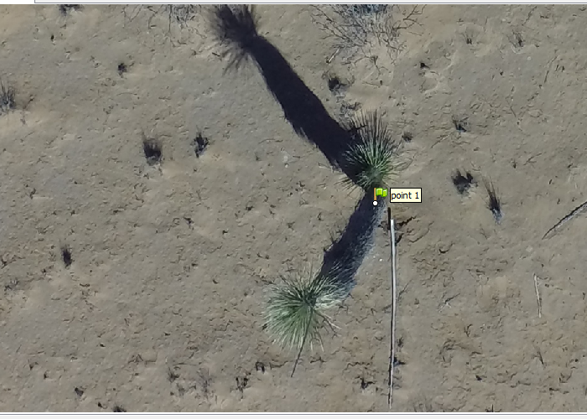
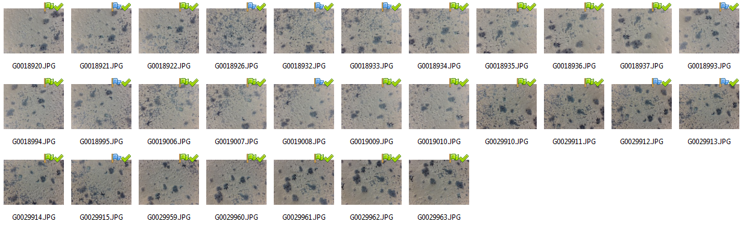
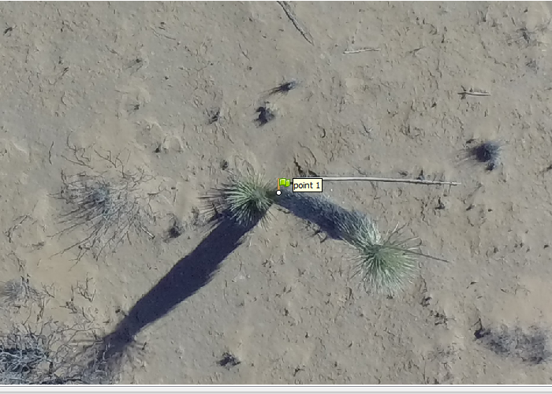
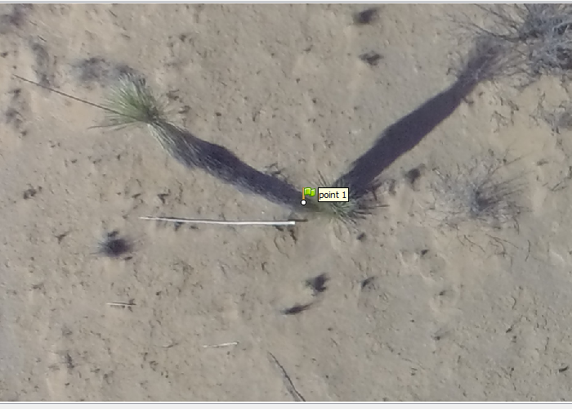
Method: structure-from-motion photogrammetry
SfM is a stereo photogrammetry for estimating 3D structures from 2D image series taken from different aspects.
Notes:
These four figures show the different four aspects of one plant. However, based on the point cloud, there are 29 projections for this plant.

Slide 9
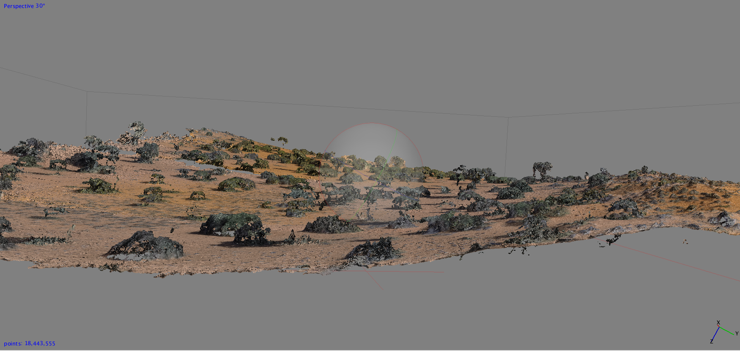
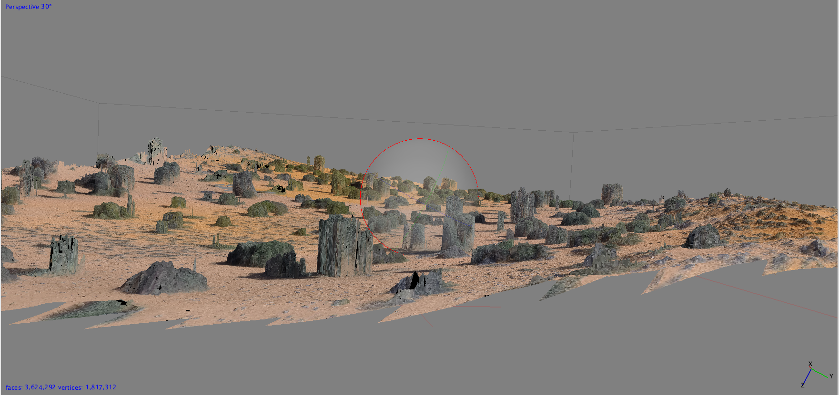
Method: image data acquisition and processing
Notes:
After taken these photos by drone, photoscan was used to build point cloud and texture.
Canopy size, bare soil gap size and plant height can be derived from orthomosaics and dsm.
1. Draw polylines in the same location of those transect lines measured in the field for all upwind and downwind treatment.
2. Measure bare soil gap sizes and canopy size by the same criteria of the field observation. Measure the highest point of plant canopy in the transect line. Measure the LPI at 1 m intervals along the transect line.

Slide 10
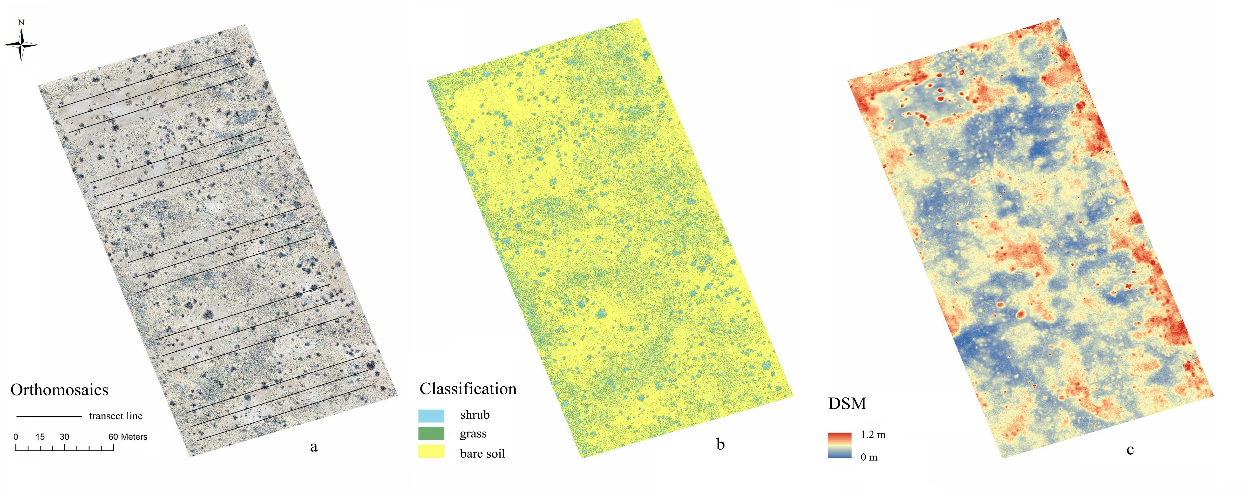
Results
Notes:
Here are the visual results including orthomosaics, classification map and DSM based on Block 3 of NEAT sites, 2017 spring
We took 3 100-m transect lines from upwind to downwind for each treatment.

Slide 11
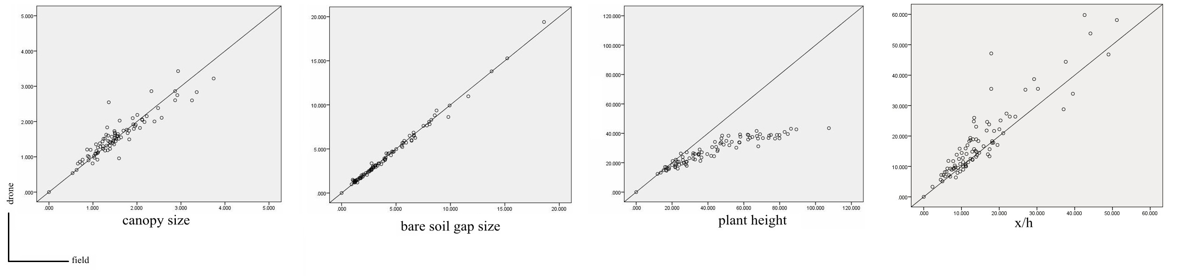
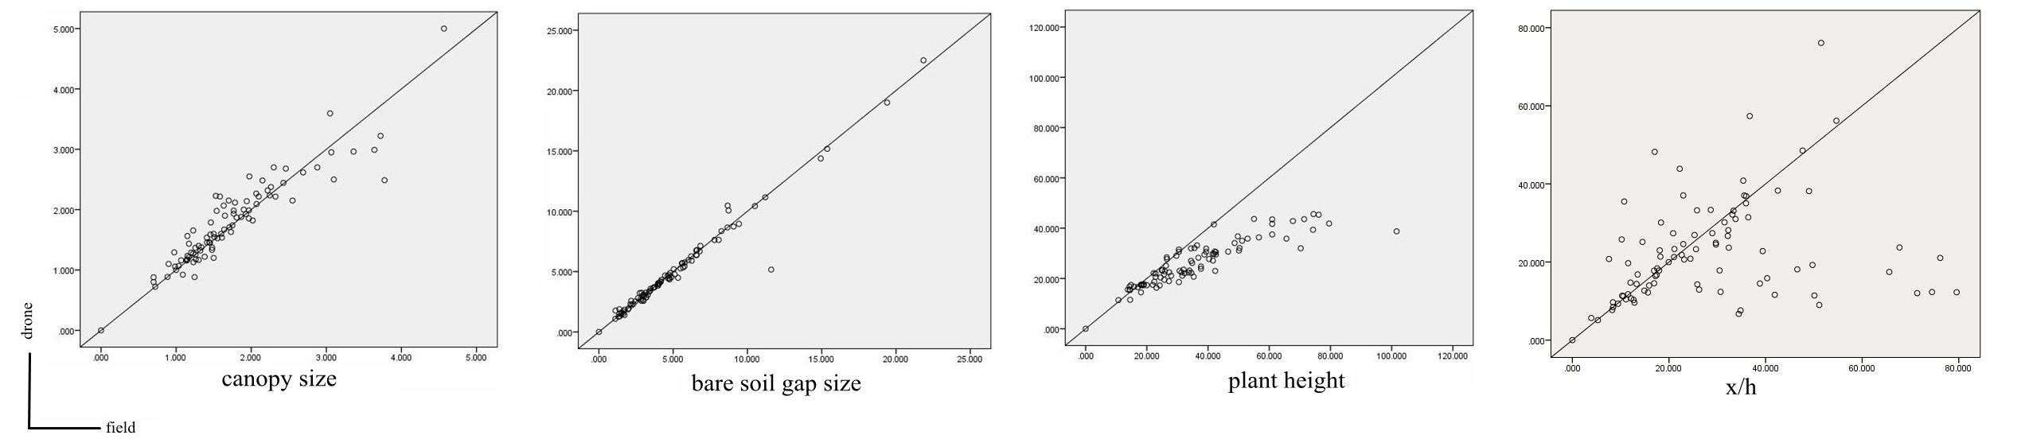
Results
2016 90 transects averaged
2017 90 transects averaged
Notes:
The scatter plots show the correlation between field measurement and drone-based remote sensing.

Slide 12
Results
2016 (90 transects)
2017 (90 transects)
Two-year Total (180 transects)

Slide 13
Results
LPI
 |  | field measurement |  |  |  | Total | User's Accuracy
 |  | Bare soil | Grass | Litter | Shrub
drone | Bare soil | 2908 | 89 | 36 | 45 | 3078 | 0.945
 | Grass | 28 | 703 | 3 | 5 | 739 | 0.951
 | Litter | 1 | 0 | 59 | 0 | 60 | 0.983
 | Shrub | 32 | 6 | 1 | 539 | 578 | 0.932
Total |  | 2969 | 798 | 99 | 589 | 4455
Producer's Accuracy |  | 0.979 | 0.88 | 0.596 | 0.915
Total Accuracy |  | 0.945
Kappa |  | 0.888

Slide 14
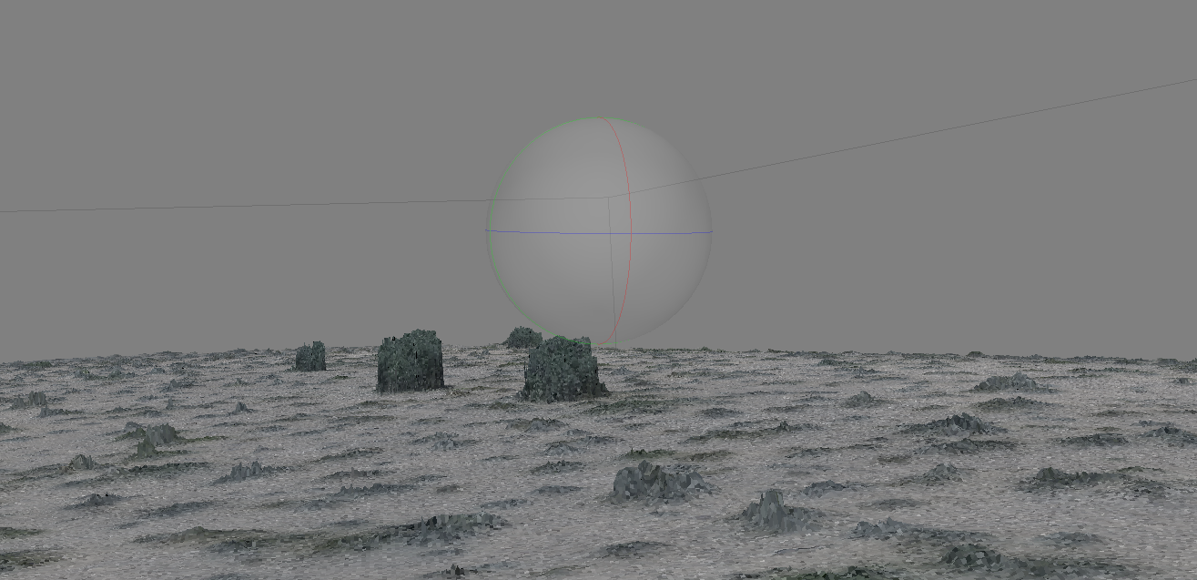
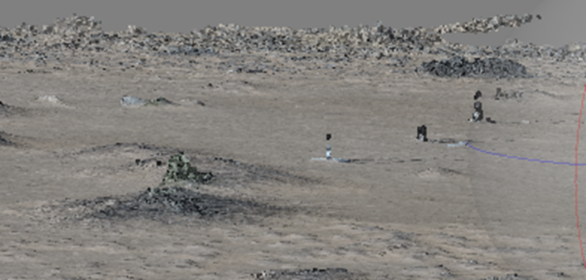
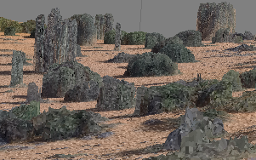
Discussion
Dona Ana Conmod site, summer
NEAT site block 3, spring
The Kalahari, winter

Slide 15
Summary
A drone-based remote sensing method to survey vegetation structure in arid and semiarid rangeland is proposed.
This method performs very well to measure canopy size, bare soil gap size and grass height. However, the method only performs well for the shrub height when the shrub has dense leaves.
This method can substitute the field measurement based on the results of this experiment, and drone-based remote sensing gives us a cheap, fast and high accuracy way to do the surveying in drylands.

Slide 16
References
McGlynn, Ian O., and Gregory S. Okin. "Characterization of shrub distribution using high spatial resolution remote sensing: Ecosystem implications for a former Chihuahuan Desert grassland." Remote Sensing of Environment101.4 (2006): 554-566.
Karl, Jason W., Michael C. Duniway, and T. Scott Schrader. "A technique for estimating rangeland canopy-gap size distributions from high-resolution digital imagery." Rangeland ecology & management 65.2 (2012): 196-207.
Herrick, Jeffrey E., et al. "Monitoring manual for grassland, shrubland and savanna ecosystems. Volume I: Quick Start. Volume II: Design, supplementary methods and interpretation." Monitoring manual for grassland, shrubland and savanna ecosystems. Volume I: Quick Start. Volume II: Design, supplementary methods and interpretation. (2005).

